Slide 1
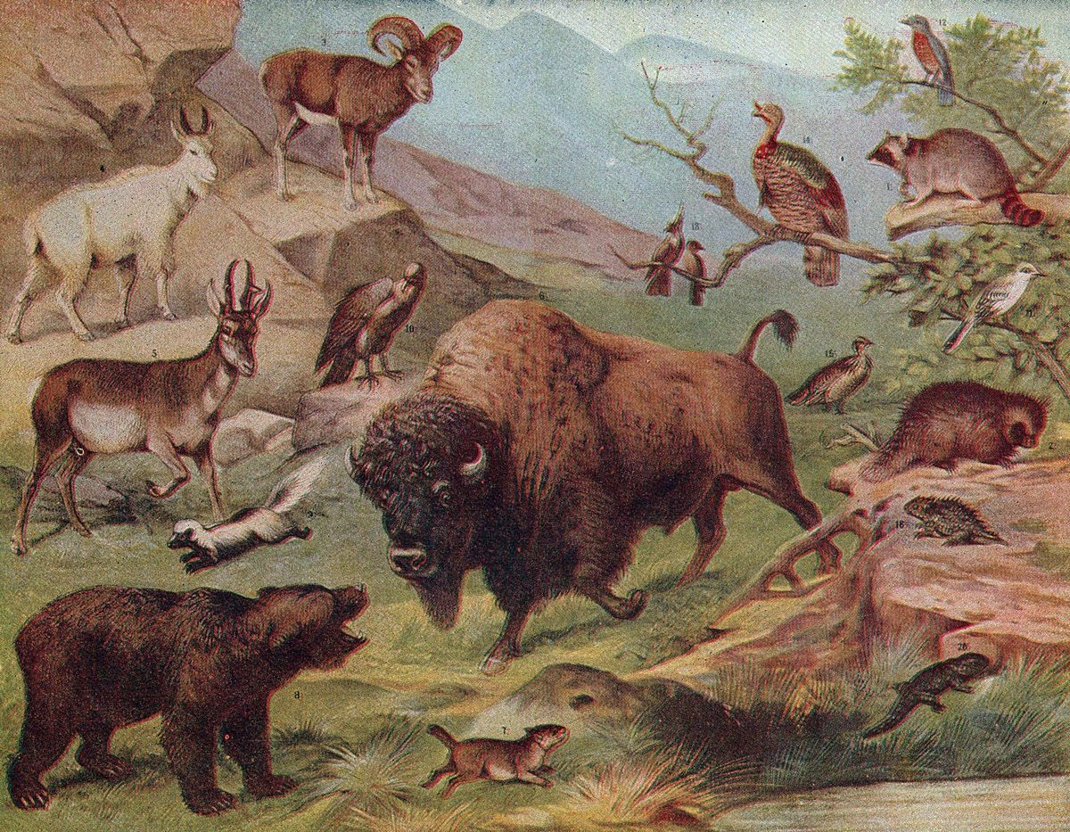
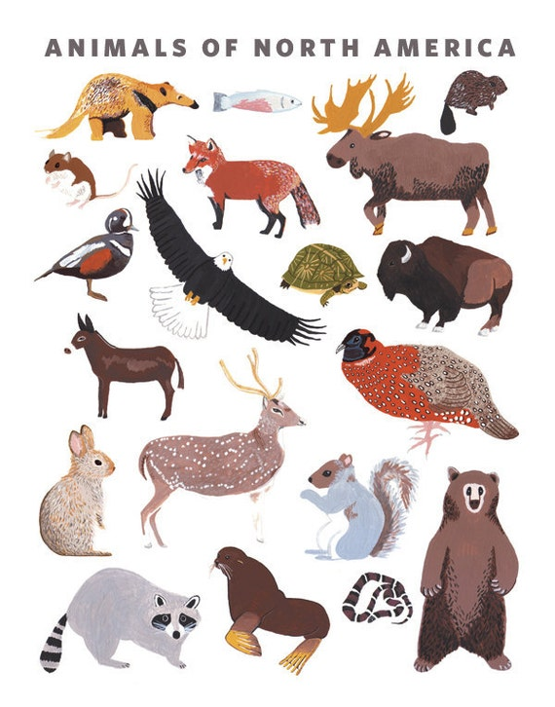
Observed Biodiversity in American National Parks
The data for this project is inspired by real data but is mostly fictional. Data files provided by Codecademy.com

Slide 2
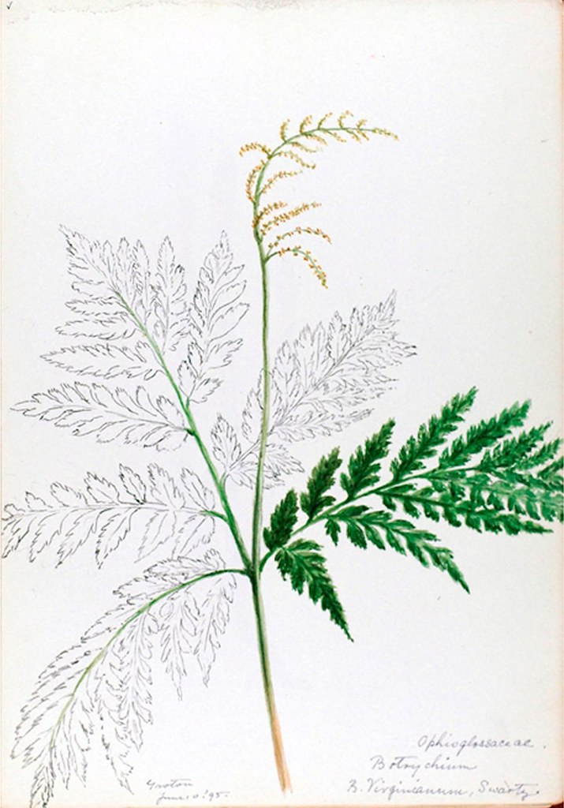
Project Goals
Analyze biodiversity data from the National Parks Service, particularly around various species observed in different national park locations.
This project will answer a few questions:
What is being studied here ?
Where were the observations taken ?
What is the most observed animal category ?
How many species are there in each category ?
What is the distribution of conservation status for species ?
Are certain types of species more likely to be endangered? Which ones ?
What are the differences between species and their conservation status and are they significant ?
Which animal is most observed (scientific name/common name) ?

Slide 3
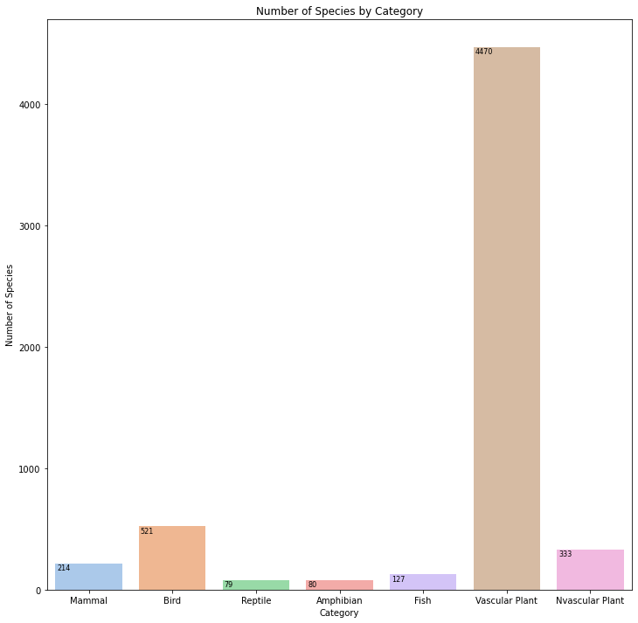
What is being studied
This is a simple chart showing what is being studied in this presentation. As you can tell, the largest variety of species, animal or plant, is the Vascular Plant. Examples include Broad-Leaved Pondweed, Butler's Sandparsley and Wild Parsnip. The Non-Vascular plants are mostly moss.

Slide 4

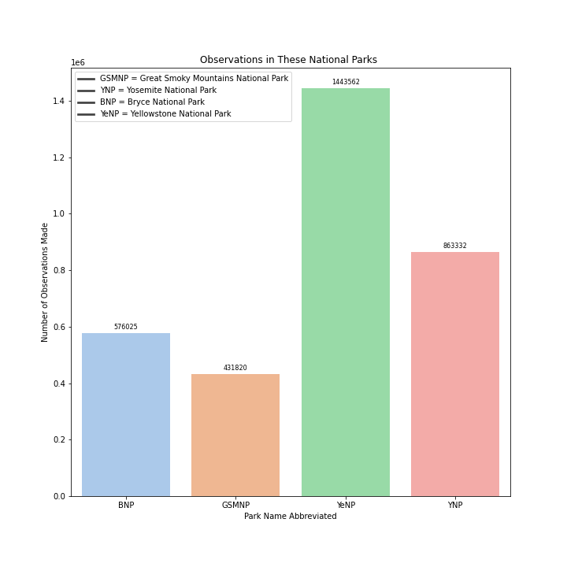
Where the observations were taken
As you can see, Yellowstone National Park is where most of the observations were taken. Yosemite was second.

Slide 5
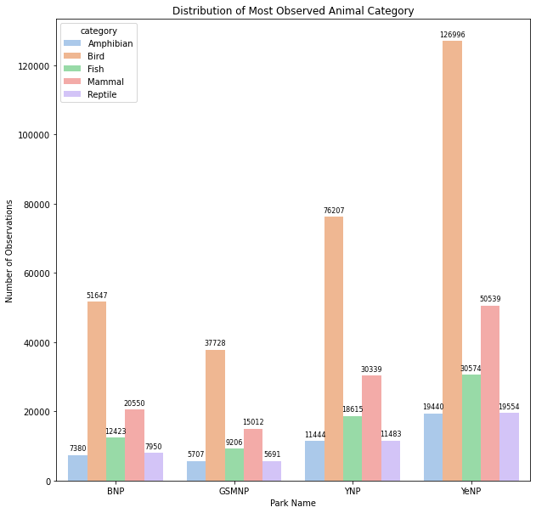
What’s the Most Observed Animal Category ?
As you can see by the graph, the most observed animal category is Birds. Yellowstone has the highest number of observations and Yosemite is second. The next most observed category is mammals, again with Yellowstone having the highest number of observations.

Slide 6
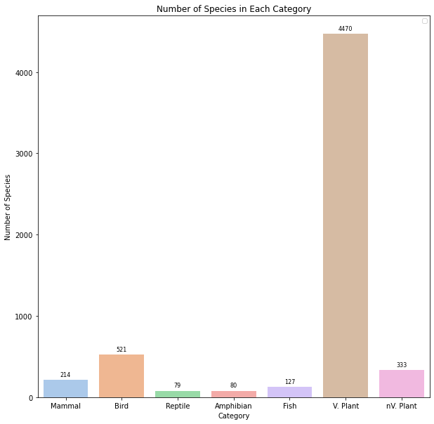
The Number of Species by Category
As you can see the Vascular Plants make up the highest number of species in one category. Reptiles have the lowest number of species.

Slide 7
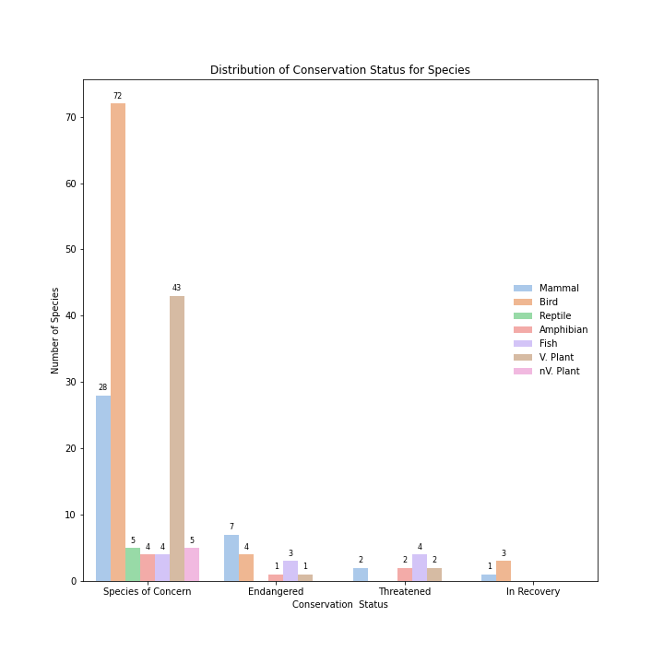
conservation status
A you can see there isn’t a category observed that doesn’t have a species of concern in it. Only two categories are ‘In Recovery’ and 5 of 7 categories have endangered species in the category.

Slide 8
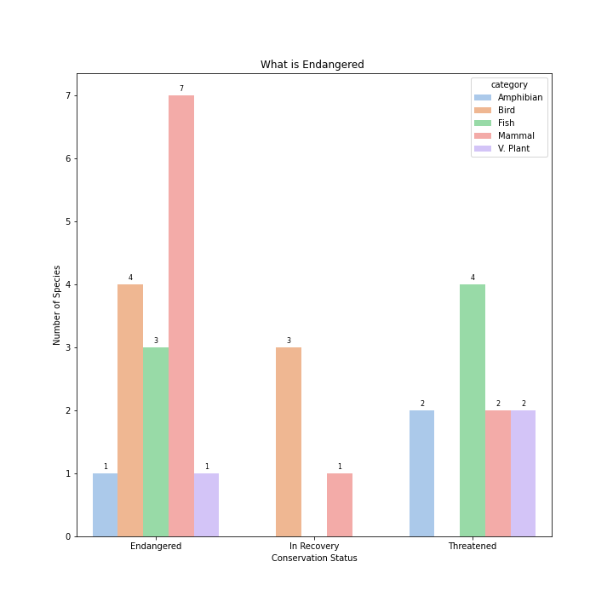
What is endangered by category
This chart shows what is considered endangered, threatened or in recovery. The statuses of species of concern and no intervention are not covered under the umbrella of ‘endangered’ asked in the question.

Slide 9
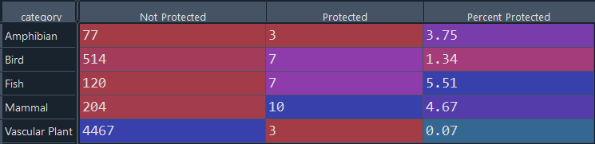
What’s protected as a percentage
The Scientific Name was used to make this chart. As you can see, by percentage, there are few species in the endangered (protected) category. I used Endangered, In Recovery and Threatened as those fall into that category. Species of Concern does not fall into the Protected category.

Slide 10
The differences between species and their conservation status using the Chi Squared tests for significance testing
There were two tests run. A comparison between mammals and birds and a test between amphibians and mammals. The standard p-value to test statistical significance is 0.05. For the value given from this test, the value of 0.013 is smaller than 0.05. In the case of mammals and birds there does seem to be significant relationship between them. The variables are dependent.
For the test between amphibians and mammals a value of .98 was given. In the case of mammals and amphibians there isn’t a significant relationship between them. The variables are independent.

Slide 11
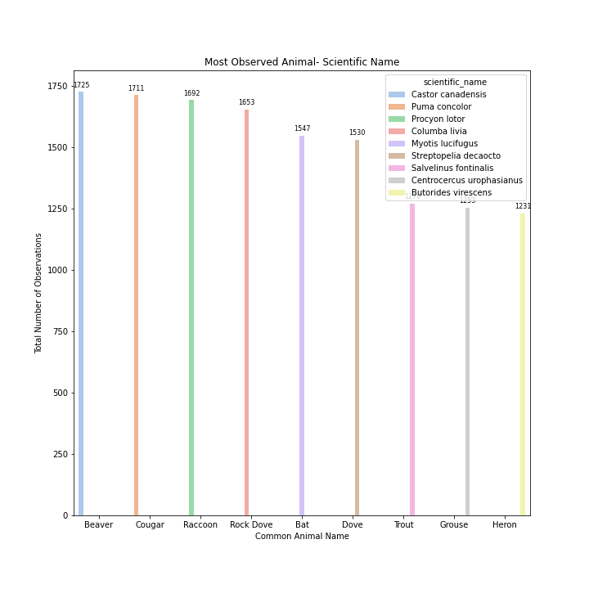
Most observed animal by scientific name
The scientific name was used to make this chart of the top 5 most observed animals. All four parks were totaled. In this chart the definition of animal was used: “a living organism that feeds on organic matter, typically having specialized sense organs and nervous system and able to respond rapidly to stimuli.” Birds, mammals, fish etc. were included. As you can see, this chart has a most observed animal that was different from the common name chart.

Slide 12
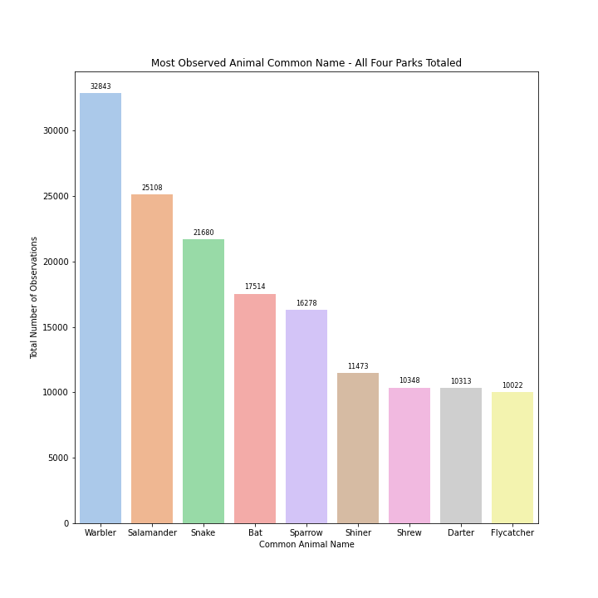
Most Observed Animal by Common NAme
The common animal name was used to make this chart of the top 9 most observed animals. All four parks were totaled. In this chart the definition of animal was used: “a living organism that feeds on organic matter, typically having specialized sense organs and nervous system and able to respond rapidly to stimuli.” Birds, mammals, fish etc. were included.

